Slide 1
SG Technologies
Beta Release

Slide 2
Changes made from Alpha release
Applied GUI
Added multiple payment options
Added handling return and unsatisfied items
Fixed bugs

Slide 3
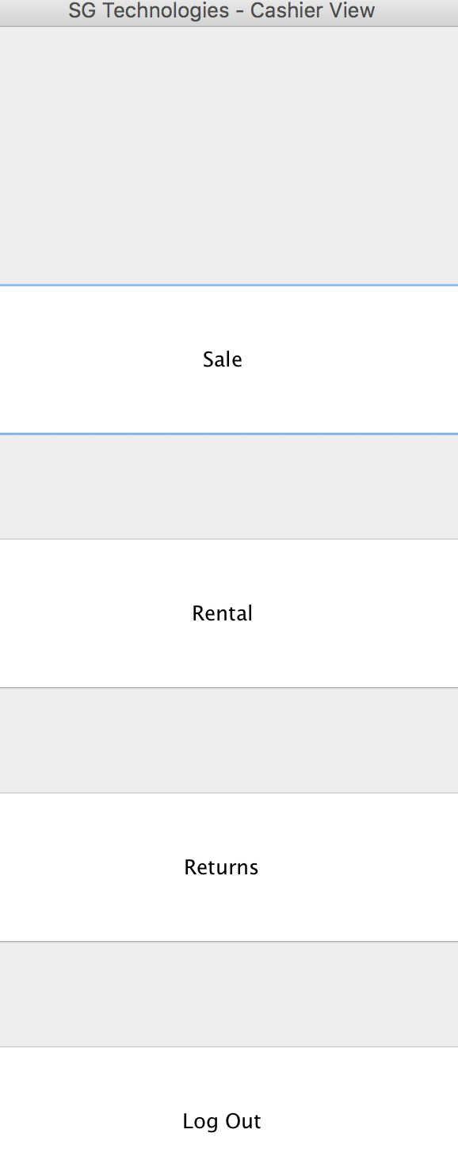
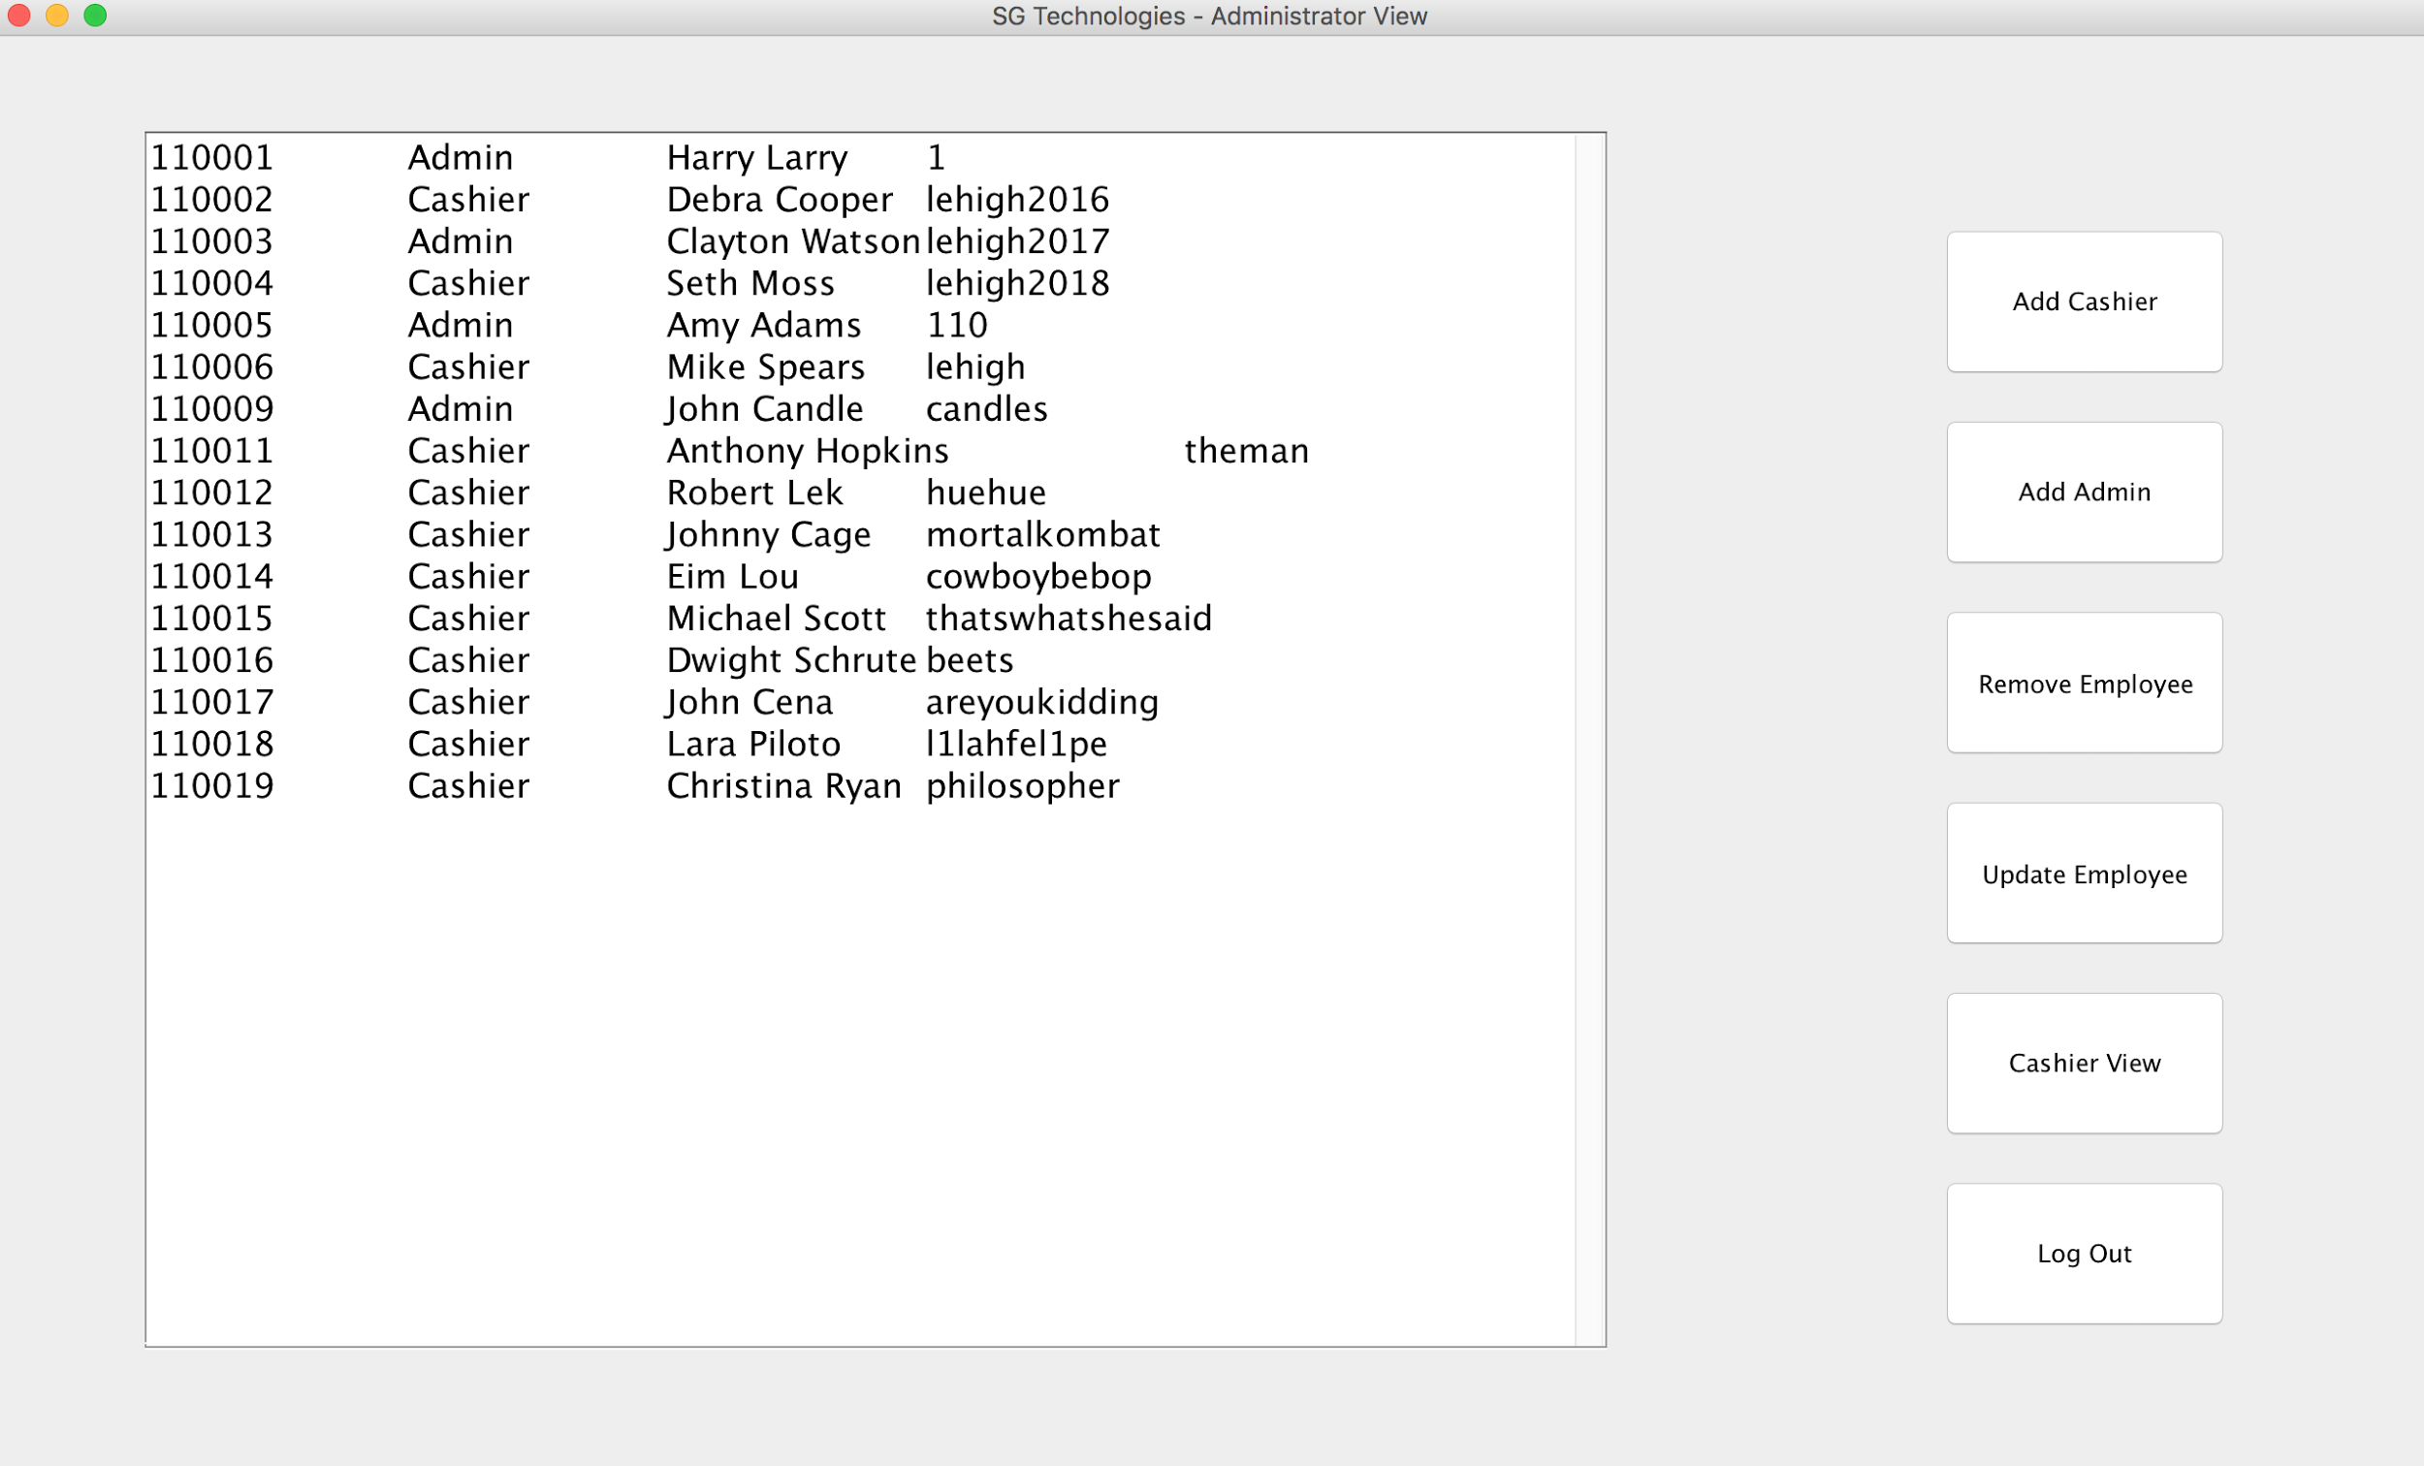
GUI

Slide 4
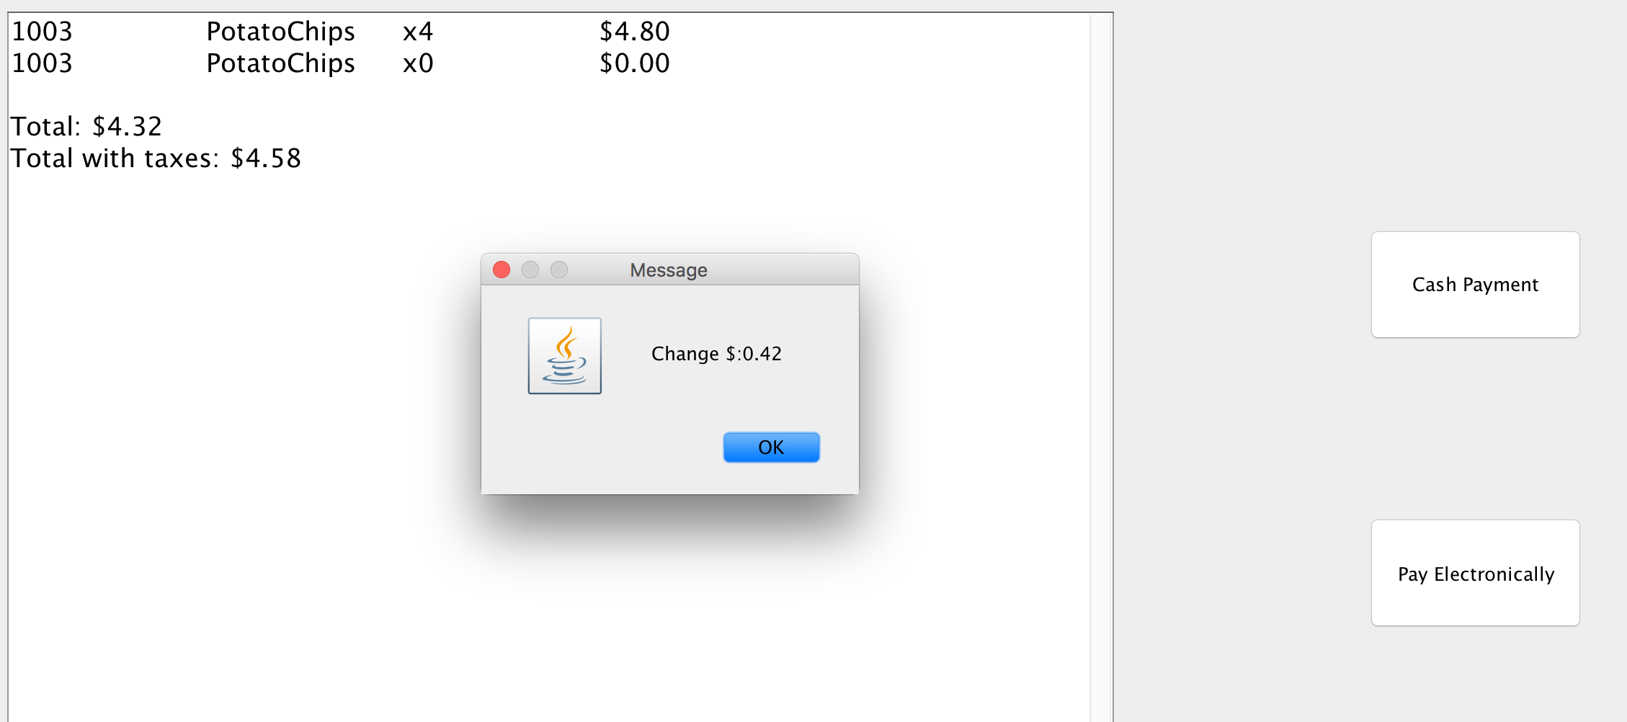
Multiple Payment Options

Slide 5
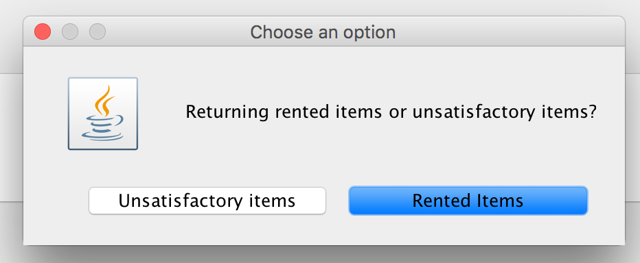
Rented Items or Unsatisfactory Items

Slide 6
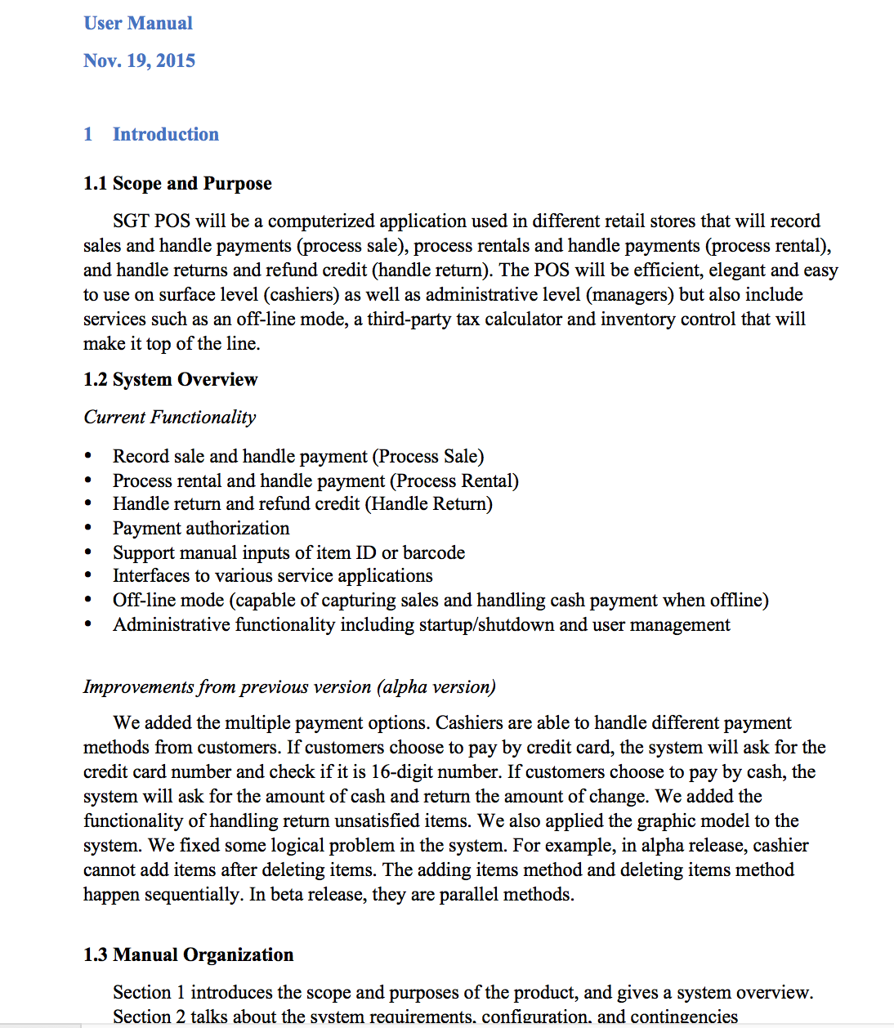
User Manual

